Slide 1
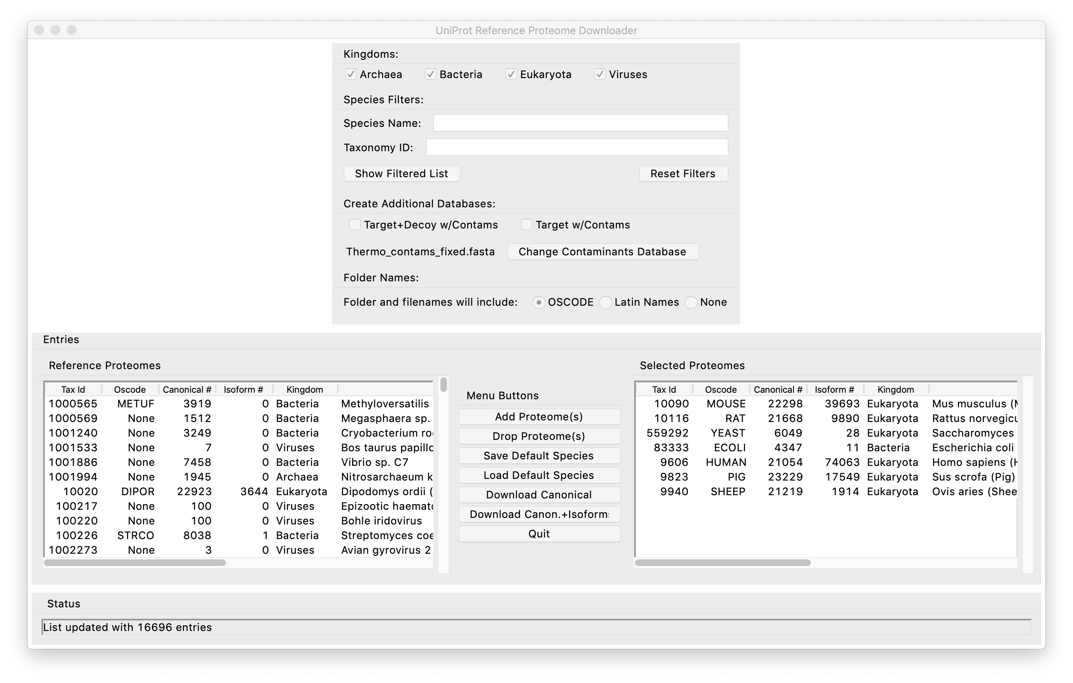
< phylogenetic kingdoms
< species substring search
apply search and update left list >
< taxonomy number search
< reset search boxes
database processing >
< change contaminants file
proteomes to download (showing saved defaults)
16696 proteome choices
^ actions

Slide 2


Slide 3
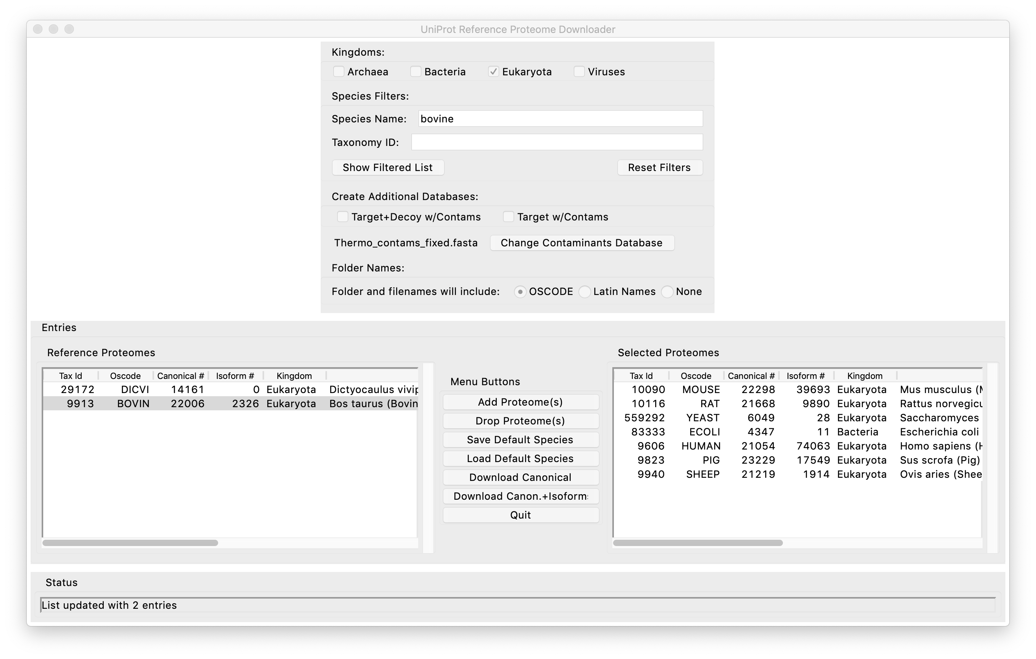

Slide 4
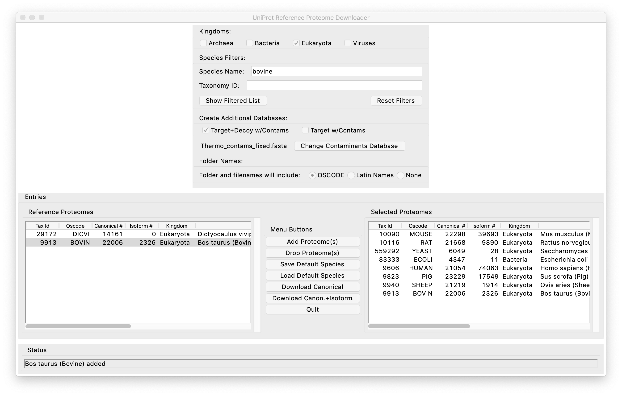

Slide 5
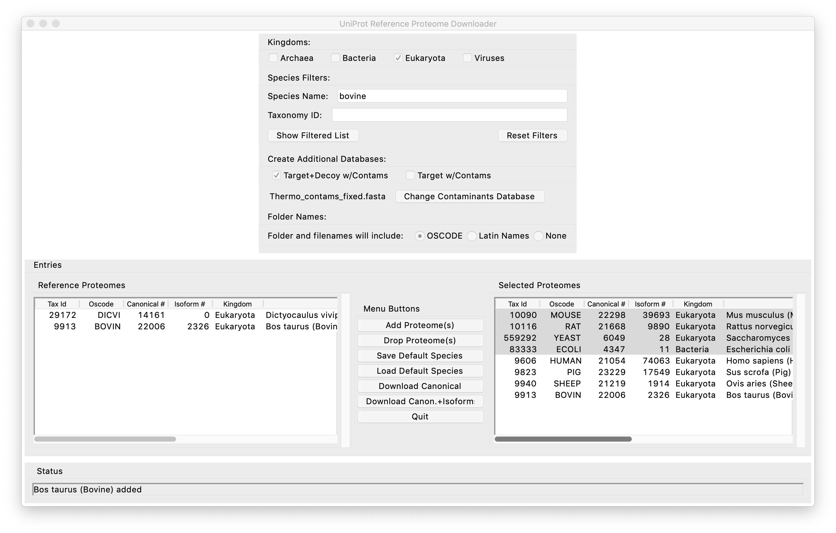

Slide 6
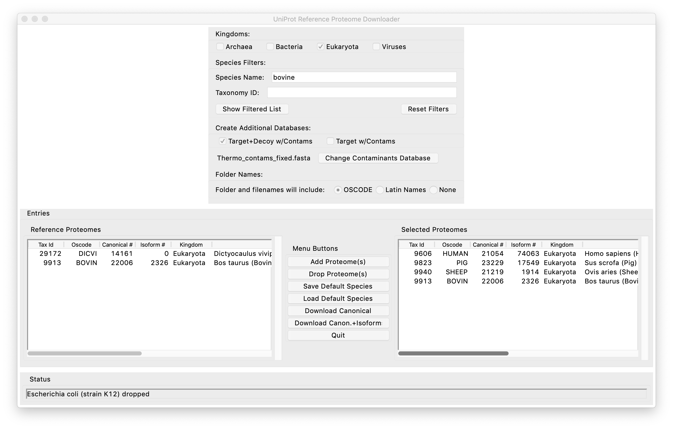
download list has been updated

Slide 7
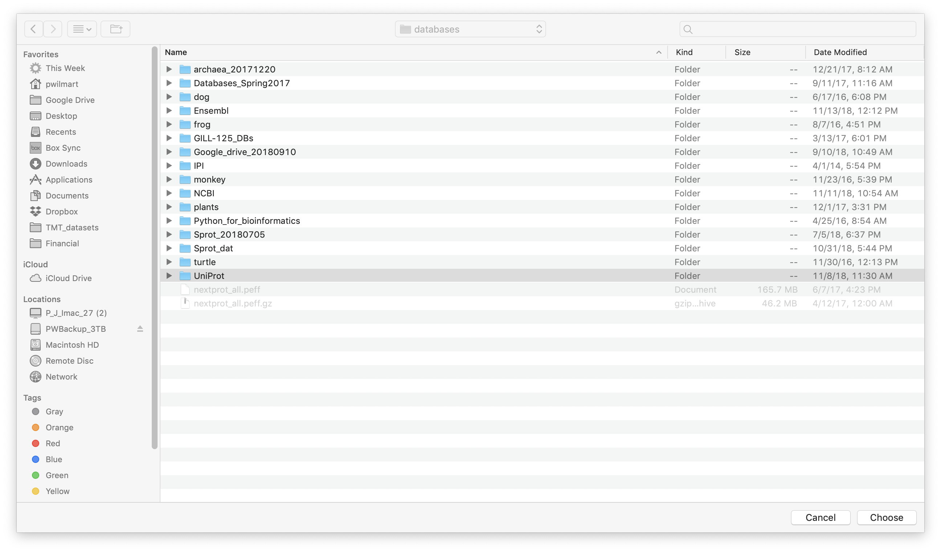

Slide 8
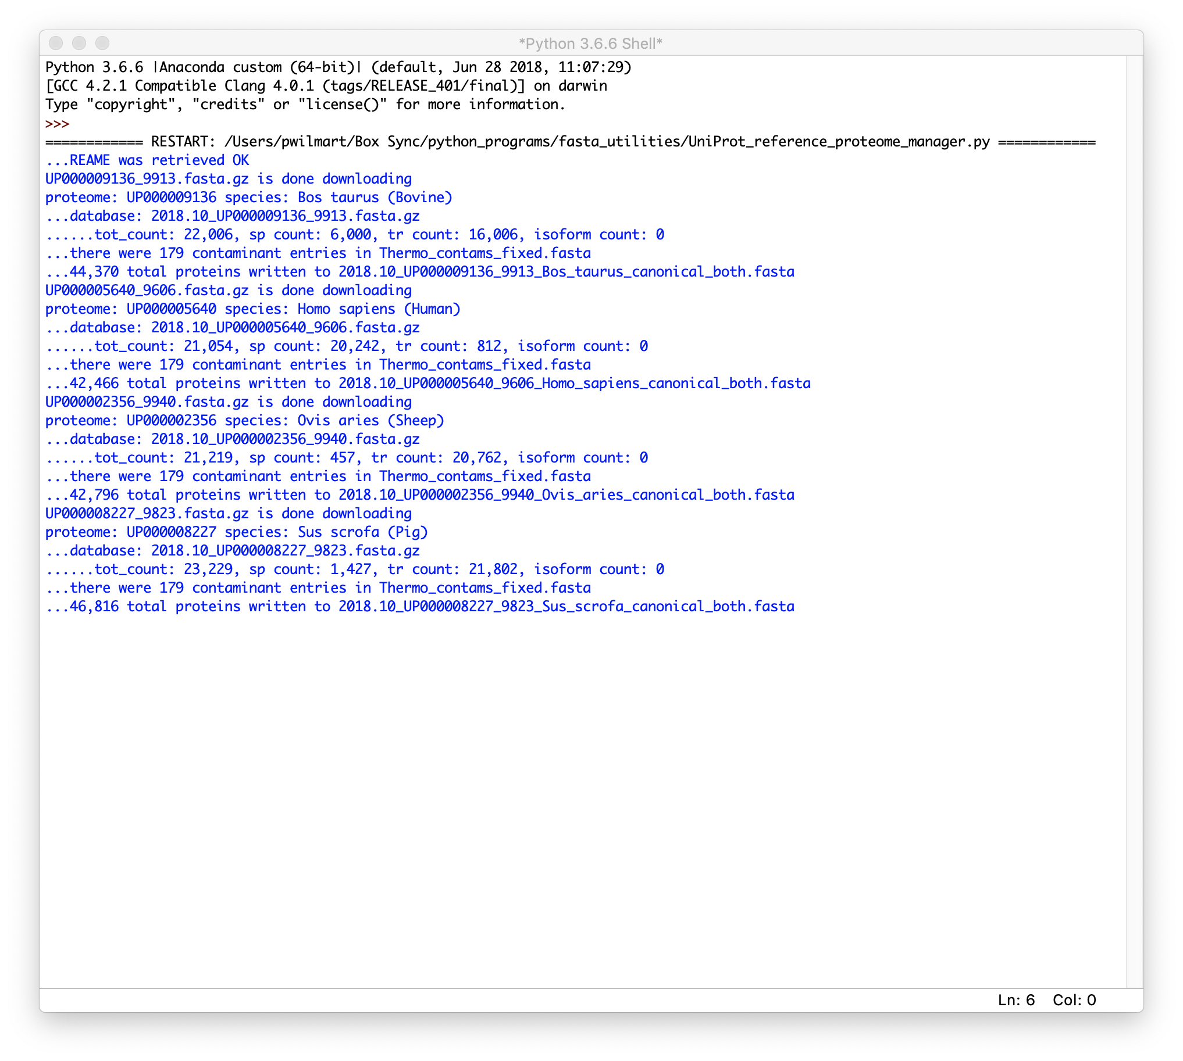
Console output shows download information

Slide 9


Slide 10
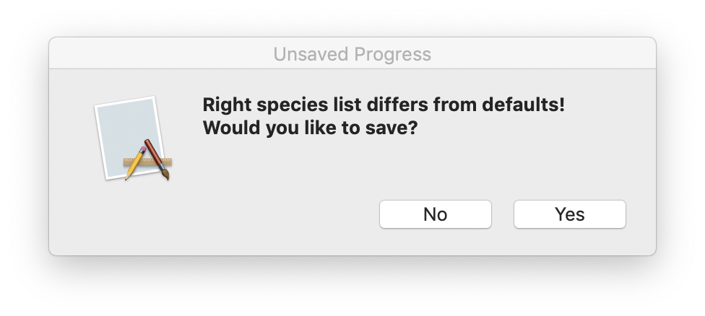
the right side list can be saved for next time

Slide 11
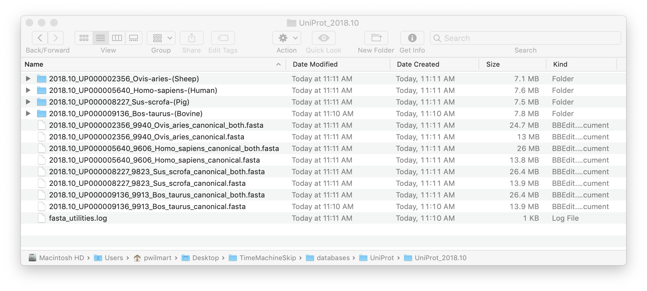
file organization and naming
release_proteome_species-name
folders with downloads
renamed databases target+decoy have “_both”
log file

